Slide 1
WEB SCRAPING IN
MACHINE LEARNING
ARUNKUMAR A
DA/DS

Slide 2
PROJECT OVERVIEW
This project focuses on collecting and analyzing product data from an e-commerce website using web scraping techniques.
The scraped data is processed, stored in a database, and analyzed to extract meaningful business insights.
The final output is visualized using dashboards to support data-driven decision-making

Slide 3
PROBLEM STATEMENT
E-commerce platforms generate large volumes of product and customer review data.
Manually analyzing this data is time-consuming and inefficient.
There is a need for an automated system to collect, store, analyze, and visualize product information effectively.

Slide 4
DATA COLLECTION BY WEB SCRAPING
Web scraping is used to automatically collect product data from e-commerce websites using Python automation tools. This method helps in gathering large amounts of data quickly and accurately
Process:
Open website using Selenium
Navigate to product pages
Extract product details (Name, Price, Rating, Reviews)

Slide 5
TOOLS USED
Python – Web scraping and data processing
Selenium – Automated web interaction
Pandas – Data cleaning and analysis
MySQL – Data storage
Power BI – Data visualization and dashboards

Slide 6

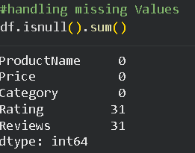
DATA CLEANING

Slide 7
EXPLORATORY DATA ANALYSIS(EDA)
Exploratory Data Analysis is used to understand the structure, patterns, and trends in the cleaned dataset before advanced analysis and visualization.
Key Analysis Performed:
Summary statistics of price, rating, and reviews
Distribution analysis of product prices
Rating-wise and category-wise comparison
Relationship between price and customer ratings
Identification of outliers and trends

Slide 8
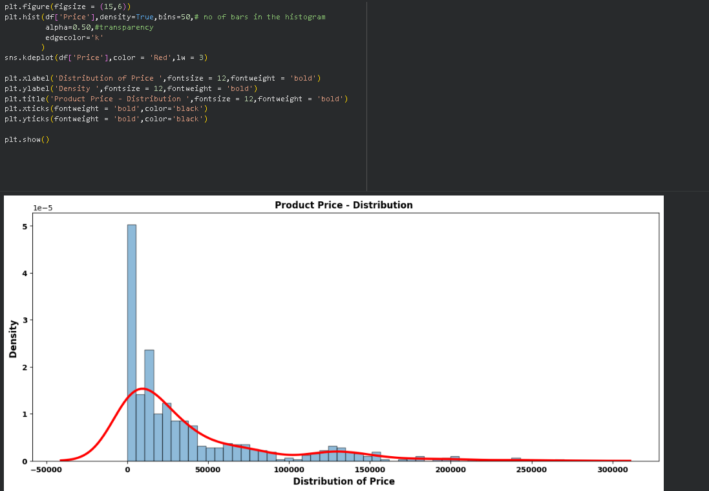
PRICE DISTRIBUTION

Slide 9
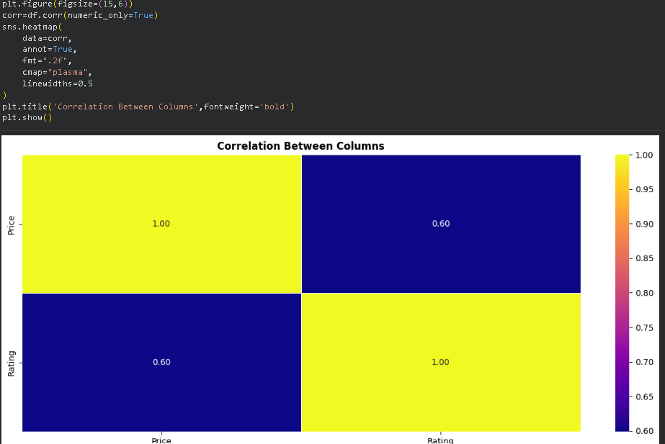
CORRELATION HEATMAP

Slide 10
STORAGE METHOD USED
Storage Method Used:
Store cleaned data into MySQL database
Create tables for product details
Insert records using Python database connectors
Ensure data integrity and consistency

Slide 11
UNSUPERVISED LEARNING (Clustering)
Unsupervised learning is a type of machine learning where the model learns patterns from data without labeled outputs. It helps in discovering hidden structures, relationships, and groupings in datasets.
Unsupervised learning = Machine learning without labeled output.
The model tries to find patterns, groups, or structure in data by itself.

Slide 12
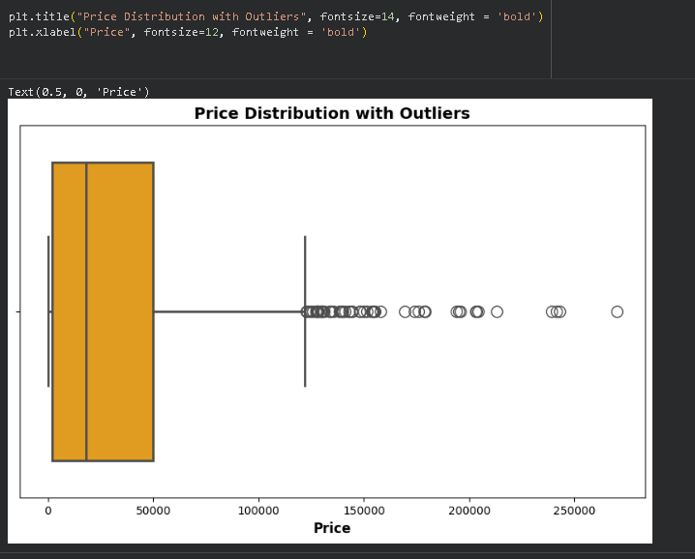

Slide 13
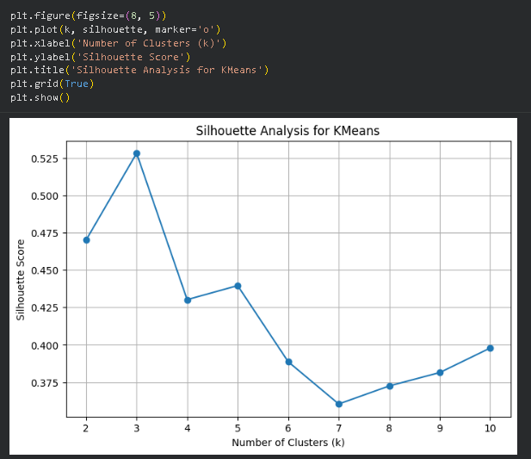

Slide 14
SUPERVISED LEARNING
Multiple classification models were implemented to predict product categories or label
Models Use
  Logistic Regression
  Support Vector Machine (SVM)
  k-Nearest Neighbors (k-NN)
  Random Forest
  XGBoost

Slide 15
INSIGHTS
Higher-rated products generally receive more customer reviews, indicating higher customer trust and popularity.
Mid-range priced products tend to have the highest number of reviews, showing strong customer demand in this price segment.
Some high-priced products have fewer reviews, suggesting niche or premium market targeting.
Certain categories show wide price variation, indicating diverse product options within the same category.
Products with consistent ratings above 4.0 tend to perform better in customer engagement.

Slide 16
RECOMMENDATIONS
Focus on stocking and promoting mid-range priced products, as they attract more customers.
Highlight high-rated products in marketing campaigns to increase sales conversion.
Improve low-rated products by analyzing customer review feedback.
Maintain competitive pricing strategy based on category price trends.
Use customer review insights to improve product quality and customer satisfaction.

Slide 17
THANK YOU

